Slide 1
Code from project

Slide 3
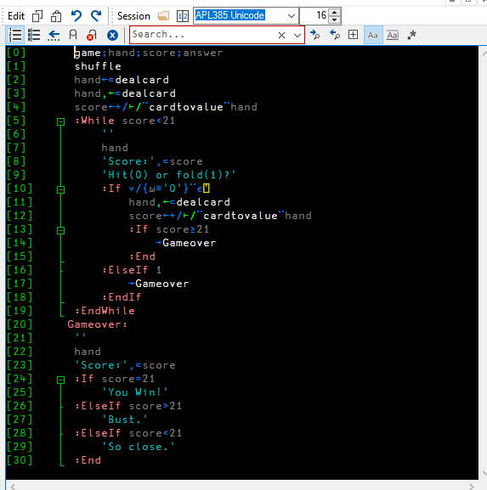
Main game loop

Slide 4
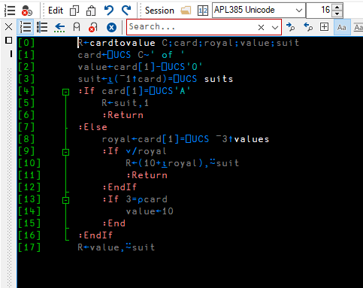
Code for converting card text to a tuple

Slide 5
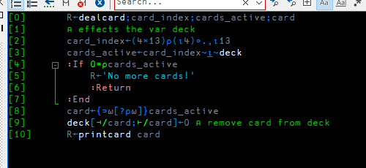
Code for dealing a card from a deck

Slide 6
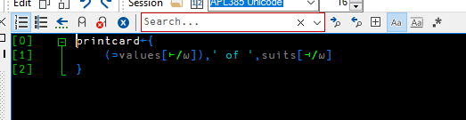
Code for printing card as a string

Slide 7
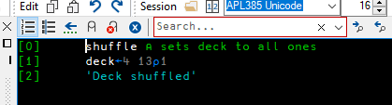
Resets deck (deck is a Boolean matrix that says whether that card is in the deck or not)

Slide 8
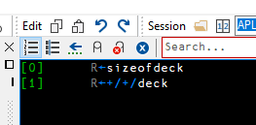
Returns the deck size by adding up the rows and columns of deck

